Slide 1
Computing Technology
Notes:
Reload codespace
Uncheck VS Code tabs
https://www.youtube.com/watch?v=H0NflGpWgKA
https://www.youtube.com/watch?v=17MctJPzR8w

Slide 2
This is CS50
If you didn't get a rubber duck 🦆 yet, ask Yuliia during break or after class!
If you'd like to attend CS50 Lunch this Fri 10/4 at 1:15pm, RSVP at cs50.ly/lunch!
We'll be joined by alumni from Meta.
Today's snack, mini blueberry muffins! 🫐
Do say hi or ask questions during break or after class!
What do today's binary bulbs spell?

Slide 3
Computing Technology

Slide 4


Slide 7
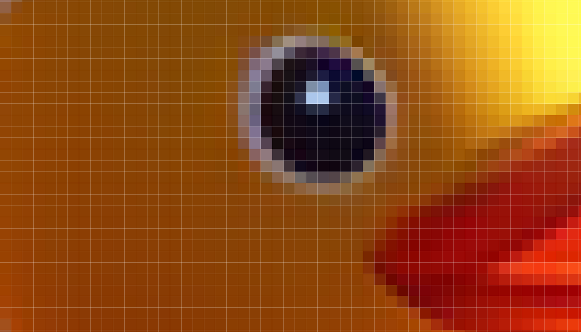

Slide 8
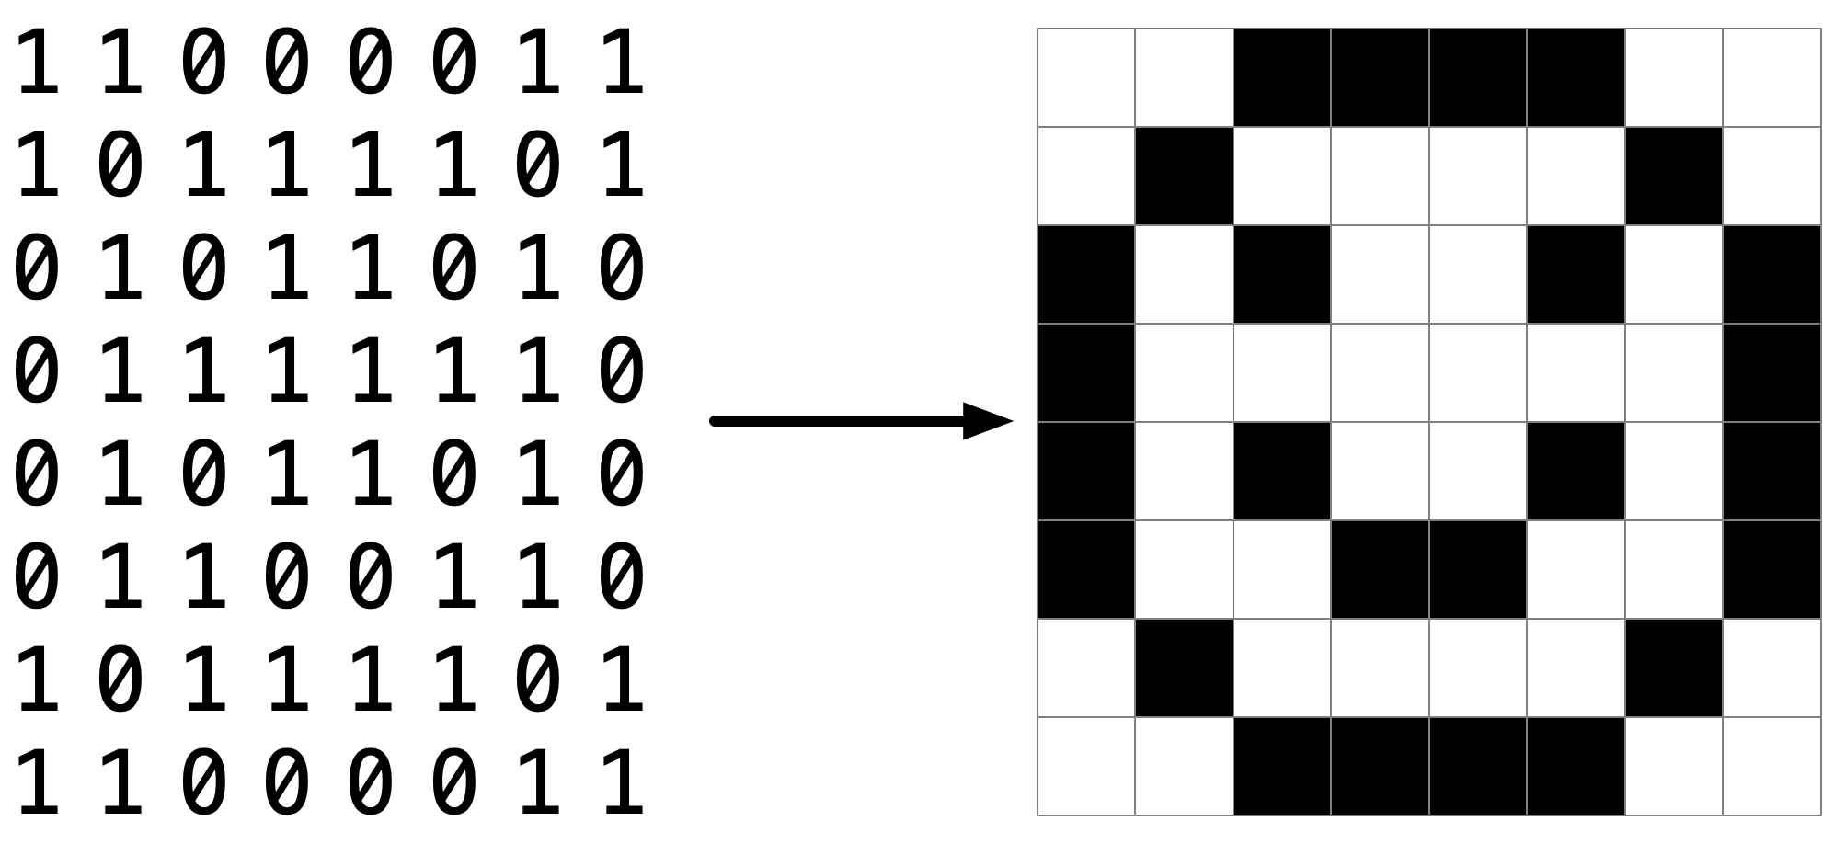

Slide 11
pixel art
Notes:
Reveal volunteer's artwork on stage, if any; invite others to make their own and send it to us

Slide 12
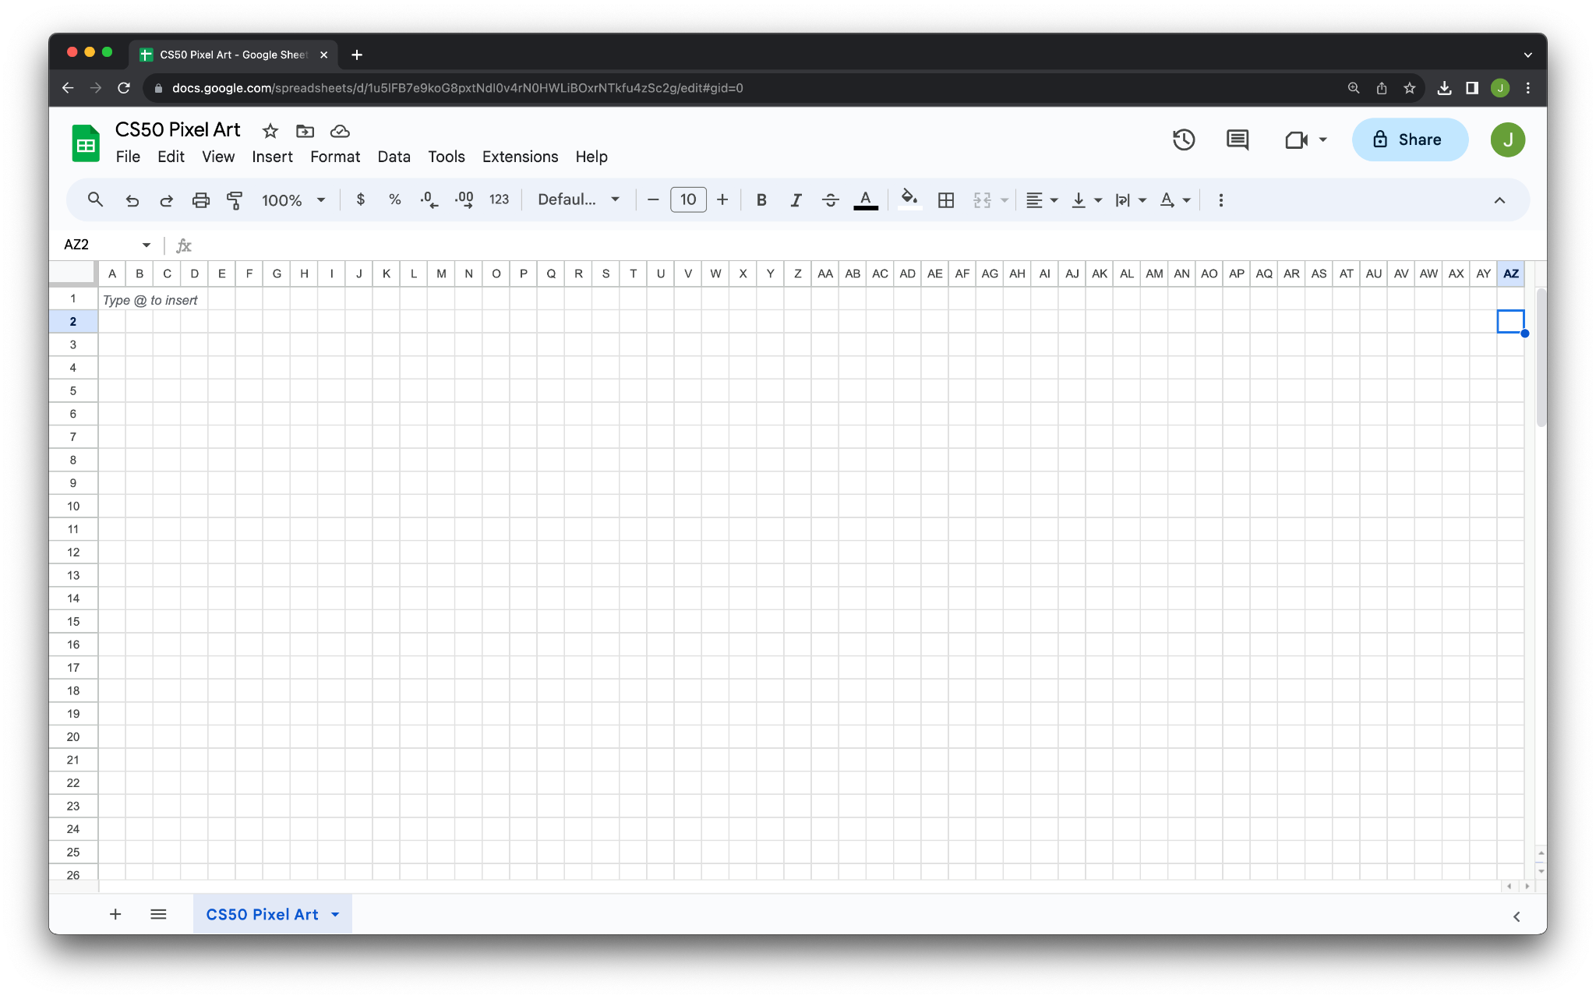

Slide 13


Slide 14
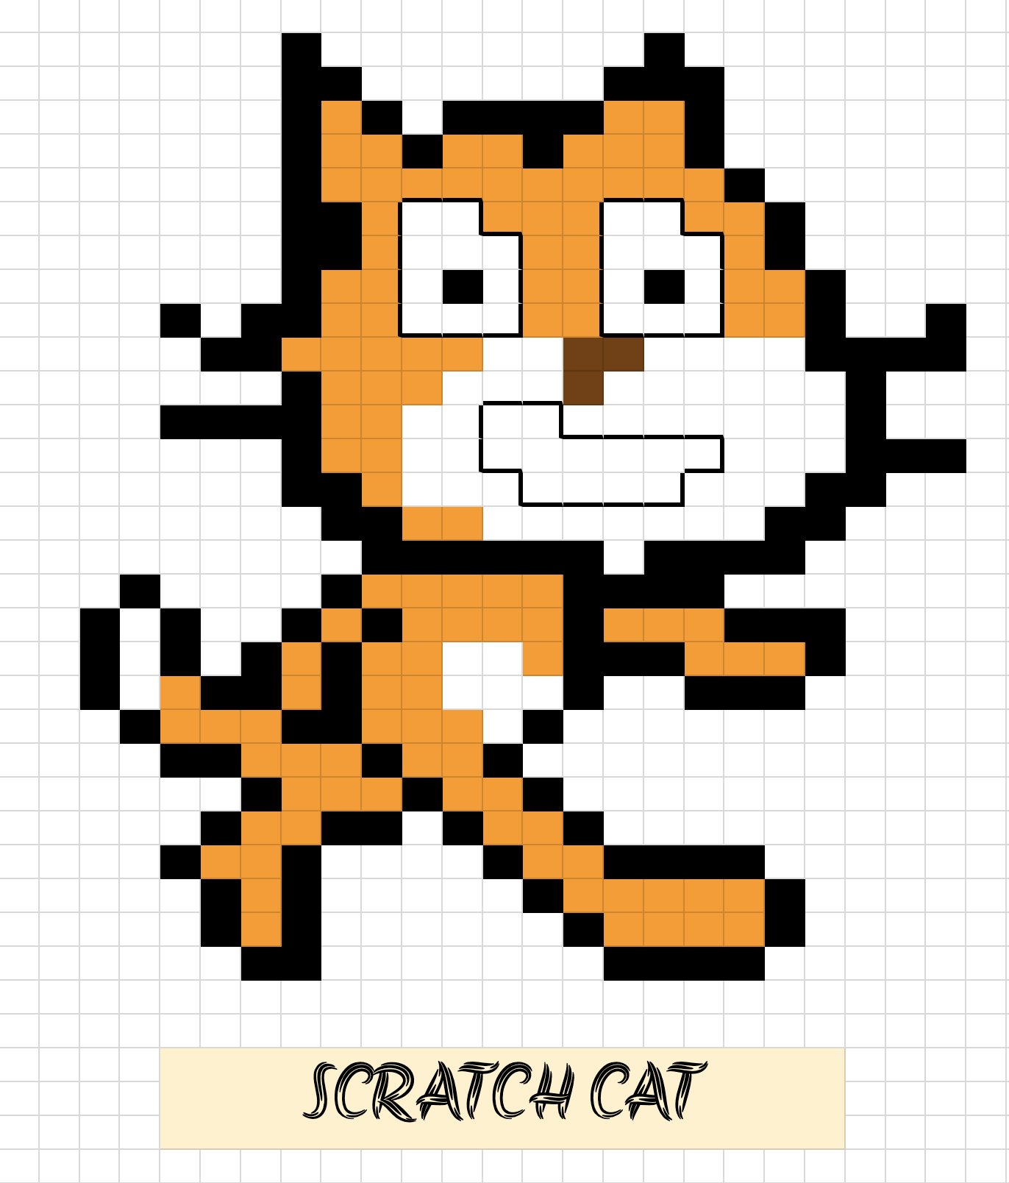

Slide 15
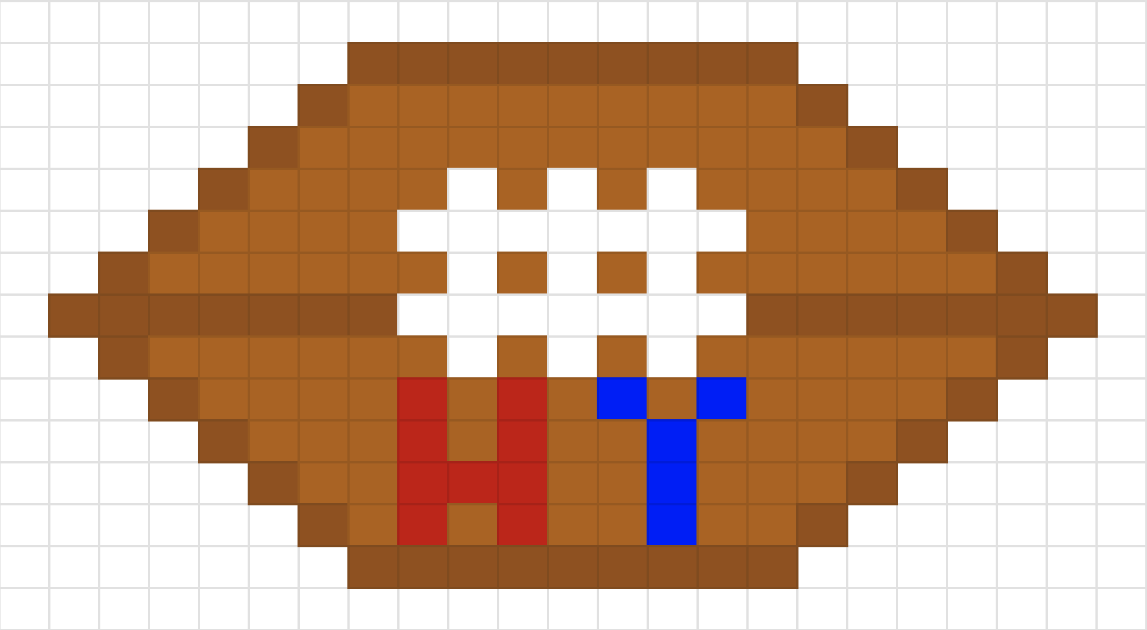

Slide 16


Slide 17
RGB

Slide 18
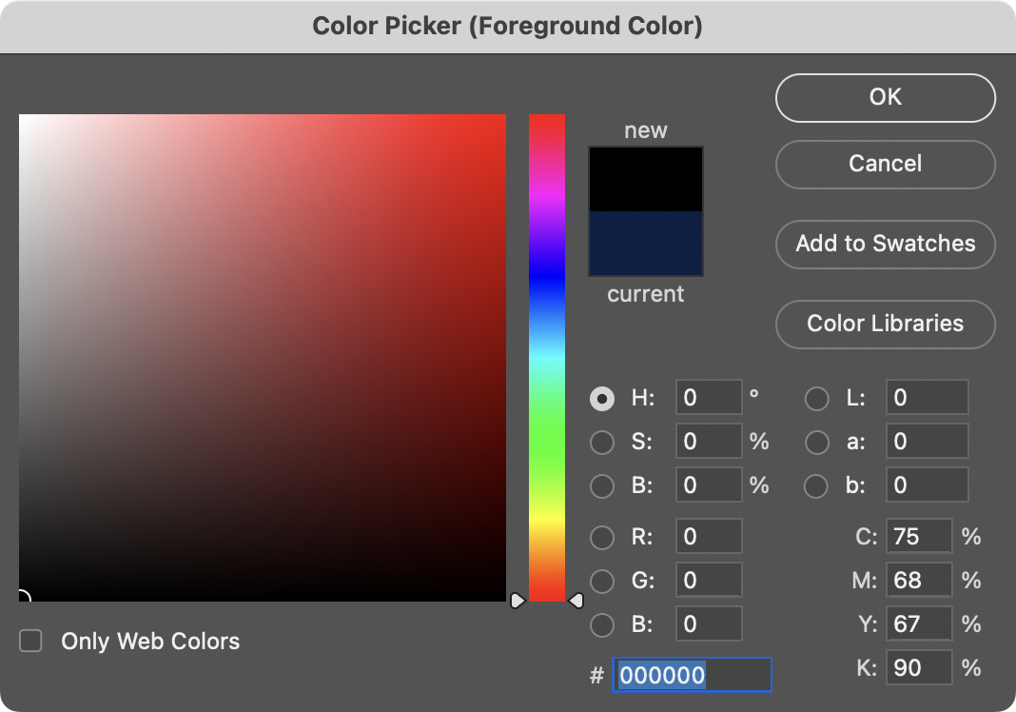

Slide 19
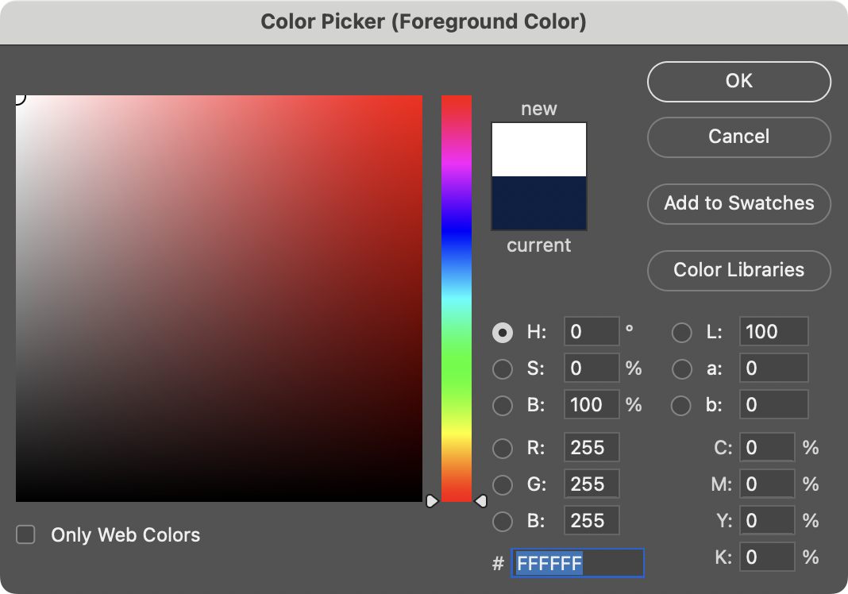
Notes:
White is 255 255 255. But what are these F's? hmmm

Slide 20
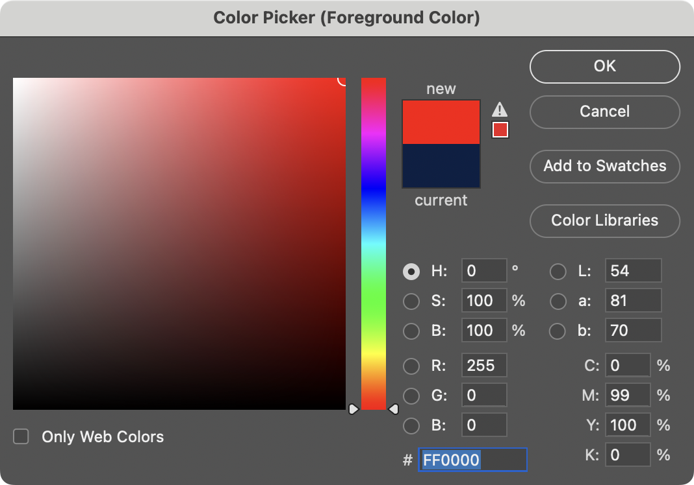

Slide 21
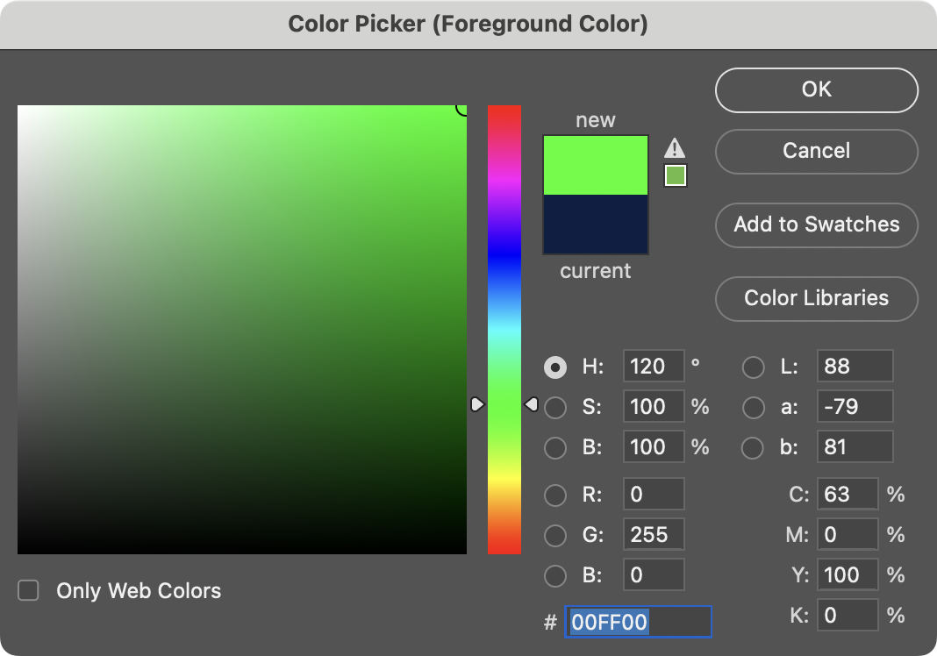

Slide 22
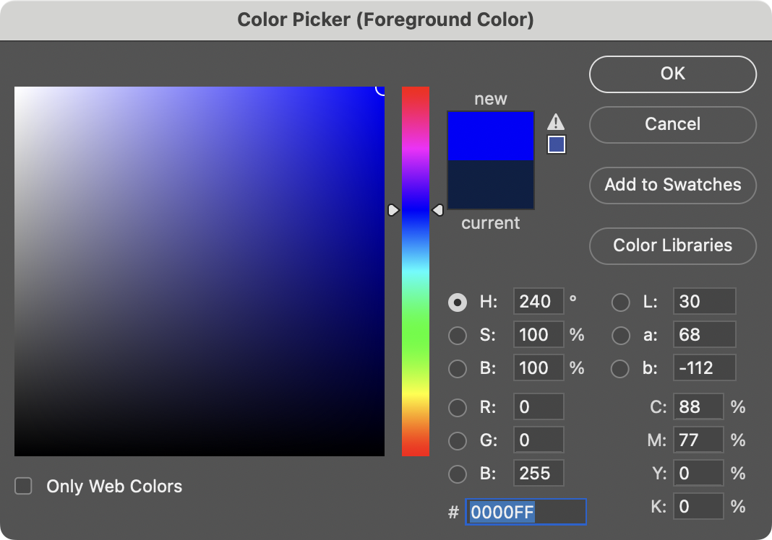

Slide 23
0 1 2 3 4 5 6 7 8 9 A B C D E F

Slide 24
0 1 2 3 4 5 6 7 8 9 A B C D E F

Slide 25
0 1 2 3 4 5 6 7 8 9 A B C D E F

Slide 26
0 1 2 3 4 5 6 7 8 9 a b c d e f

Slide 27
hexadecimal

Slide 28
base-16

Slide 29
16¹
16⁰
# #

Slide 30
16
1
# #

Slide 31
16
1
00

Slide 32
16
1
01

Slide 33
16
1
02

Slide 34
16
1
03

Slide 35
16
1
04

Slide 36
16
1
05

Slide 37
16
1
06

Slide 38
16
1
07

Slide 39
16
1
08

Slide 40
16
1
09

Slide 41
16
1
0A
Notes:
"ten"

Slide 42
16
1
0B
Notes:
"eleven"

Slide 43
16
1
0C

Slide 44
16
1
0D

Slide 45
16
1
0E

Slide 46
16
1
0F

Slide 47
16
1
10
Notes:
"one zero" not "ten"

Slide 48
16
1
11
Notes:
"one one", not "eleven"

Slide 49
16
1
12

Slide 50
16
1
13

Slide 51
16
1
14

Slide 52
16
1
…

Slide 53
16
1
FF

Slide 54
16
1
FF
16 × F
+
1 × F

Slide 55
16
1
FF
16 × 15
+
1 × 15

Slide 56
16
1
FF
240
+
15

Slide 57
16
1
FF
255
Notes:
So why is hex popular?

Slide 58
FF
Notes:
So why is hex popular?

Slide 59
F F
Notes:
So why is hex popular?

Slide 60
1111 1111
Notes:
So why is hex popular?

Slide 62
0 | 1 | 2 | 3 | 4 | 5 | 6 | 7
8 | 9 | 10 | 11 | 12 | 13 | 14 | 15
16 | 17 | 18 | 19 | 20 | 21 | 22 | 23
24 | 25 | 26 | 27 | 28 | 29 | 30 | 31

Slide 63
0 | 1 | 2 | 3 | 4 | 5 | 6 | 7
8 | 9 | A | B | C | D | E | F
10 | 11 | 12 | 13 | 14 | 15 | 16 | 17
18 | 19 | 1A | 1B | 1C | 1D | 1E | 1F

Slide 64
0 | 1 | 2 | 3 | 4 | 5 | 6 | 7
8 | 9 | A | B | C | D | E | F
10 | 11 | 12 | 13 | 14 | 15 | 16 | 17
18 | 19 | 1A | 1B | 1C | 1D | 1E | 1F

Slide 65
0x0 | 0x1 | 0x2 | 0x3 | 0x4 | 0x5 | 0x6 | 0x7
0x8 | 0x9 | 0xA | 0xB | 0xC | 0xD | 0xE | 0xF
0x10 | 0x11 | 0x12 | 0x13 | 0x14 | 0x15 | 0x16 | 0x17
0x18 | 0x19 | 0x1A | 0x1B | 0x1C | 0x1D | 0x1E | 0x1F

Slide 66
int n = 50;
Notes:
addresses0.c
Consider this code, how's it stored in memory?

Slide 68
 |  |  |  | 50 n

Slide 69
 |  |  |  | 50 0x123

Slide 70
&
*
Notes:
It turns out C has two operators that let us see and access addresses like that

Slide 71
%p
Notes:
addresses1.c

Slide 72
pointers
Notes:
A pointer is essentially an address, or more precisely a variable that can store an address.

Slide 73
int n = 50;
int *p = &n;
Notes:
addresses{2,3}.c

Slide 74
int n = 50;
int *p = &n;

Slide 75
int n = 50;
int* p = &n;

Slide 76
int n = 50;
int * p = &n;

Slide 77
int n = 50;
int *p = &n;

Slide 79
 |  |  |  | 50 n

Slide 80
 |  |  |  | 50 0x123

Slide 81
0x123 p
 |  |  |  | 50 0x123

Slide 82
0x123 p
 |  |  |  | 50 0x123

Slide 83
p
 |  |  |  | 50 0x123
Notes:
MAILBOX DEMO

Slide 84
string

Slide 85
string s = "HI!";

Slide 86
 |  |  | H | I | ! | \0

Slide 87
 |  |  | H s[0] | I s[1] | ! s[2] | \0 s[3]

Slide 88
 |  |  | H 0x123 | I 0x124 | ! 0x125 | \0 0x126

Slide 89
s
 |  |  | H 0x123 | I 0x124 | ! 0x125 | \0 0x126
Notes:
addresses{4,5}.c

Slide 90
0x123 s
 |  |  | H 0x123 | I 0x124 | ! 0x125 | \0 0x126
Notes:
addresses{4,5}.c

Slide 91
s
 |  |  | H 0x123 | I 0x124 | ! 0x125 | \0 0x126 | 0x127
Notes:
But who cares about the specific addresses, think of this just as a pointer literally, an arrow.

Slide 92
string s = "HI!";
Notes:
addresses6.c

Slide 93
string s = "HI!";

Slide 94
char *s = "HI!";
Notes:
addresses7.c
DROP TRAINING WHEELS.
It's just an address.

Slide 95
typedef struct
{
string name;
string number;
} person;
Notes:
So what is "string"? It's a type we defined for you. In fact, recall how we made our own type last week for a person.

Slide 96
typedef struct
{
string name;
string number;
} person;

Slide 97
typedef struct
{
string name;
string number;
} person;

Slide 98
typedef struct
{
string name;
string number;
} person;

Slide 99
typedef
Notes:
For instance, you could alias "integer" to be the same as "int". But no need to do that.

Slide 100
typedef int

Slide 101
typedef int integer;

Slide 102
typedef

Slide 103
typedef char *

Slide 104
typedef char * string;

Slide 105
typedef uint8_t BYTE;

Slide 106
typedef uint8_t BYTE;

Slide 107
typedef uint8_t BYTE;

Slide 108
typedef char *string;

Slide 109
typedef char *string;

Slide 110
typedef char *string;

Slide 111
cs50.h

Slide 112
pointer arithmetic
Notes:
addresses{8,9,10}.c
Were these ints instead of chars, you would still do +1, and the compiler would know that it's really +4.

Slide 113
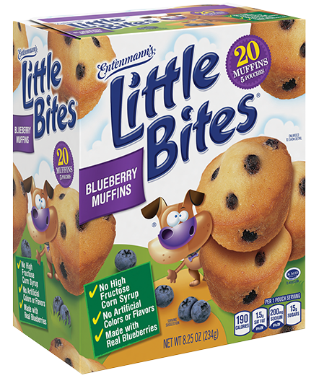
Notes:
https://www.littlebites.com/variety/little-bites-blueberry-muffins

Slide 114
typedef char * string;

Slide 115
typedef char *string;

Slide 116
Notes:
compare0.c

Slide 117
50 i |  |  |  | 50 j

Slide 118
strcmp
Notes:
compare{1,2}.c
Have to type "HI!"

Slide 120
s

Slide 121
s
 |  | H | I | ! | \0

Slide 122
s
 |  | H 0x123 | I 0x124 | ! 0x125 | \0 0x126

Slide 123
0x123 s
 |  | H 0x123 | I 0x124 | ! 0x125 | \0 0x126

Slide 124
0x123 s |  |  |  |  |  |  |  | t
 |  | H 0x123 | I 0x124 | ! 0x125 | \0 0x126

Slide 125
0x123 s |  |  |  |  |  |  |  | t
 |  | H 0x123 | I 0x124 | ! 0x125 | \0 0x126 |  |  |  |  | H | I | ! | \0

Slide 126
0x123 s |  |  |  |  |  |  |  | t
 |  | H 0x123 | I 0x124 | ! 0x125 | \0 0x126 |  |  |  |  | H 0x456 | I 0x457 | ! 0x458 | \0 0x459

Slide 127
0x123 s |  |  |  |  |  |  |  | 0x456 t
 |  | H 0x123 | I 0x124 | ! 0x125 | \0 0x126 |  |  |  |  | H 0x456 | I 0x457 | ! 0x458 | \0 0x459

Slide 128
s |  |  |  |  |  |  |  | t
 |  | H 0x123 | I 0x124 | ! 0x125 | \0 0x126 |  |  |  |  | H 0x456 | I 0x457 | ! 0x458 | \0 0x459
Notes:
compare{3,4}.c

Slide 129
Notes:
copy{0,1}.c
Have to use "hi!" in lowercase

Slide 130
s

Slide 131
s
 |  | h | i | ! | \0

Slide 132
s
 |  | h 0x123 | i 0x124 | ! 0x125 | \0 0x126

Slide 133
0x123 s
 |  | h 0x123 | i 0x124 | ! 0x125 | \0 0x126

Slide 134
0x123 s |  |  |  |  |  |  |  | t
 |  | h 0x123 | i 0x124 | ! 0x125 | \0 0x126

Slide 135
0x123 s |  |  |  |  |  |  |  | 0x123 t
 |  | h 0x123 | i 0x124 | ! 0x125 | \0 0x126

Slide 136
s |  |  |  |  |  |  |  | t
 |  | h 0x123 | i 0x124 | ! 0x125 | \0 0x126

Slide 137
s |  |  |  |  |  |  |  | t
 |  | H 0x123 | i 0x124 | ! 0x125 | \0 0x126

Slide 138
malloc
free
…
Notes:
copy{2,3,4}.c

Slide 139
s
 |  | h 0x123 | i 0x124 | ! 0x125 | \0 0x126

Slide 140
s |  |  |  |  |  |  |  | t
 |  | h 0x123 | i 0x124 | ! 0x125 | \0 0x126

Slide 141
s |  |  |  |  |  |  |  | t
 |  | h 0x123 | i 0x124 | ! 0x125 | \0 0x126 |  |  |  |  | 0x456 | 0x457 | 0x458 | 0x459

Slide 142
s |  |  |  |  |  |  |  | t
 |  | h 0x123 | i 0x124 | ! 0x125 | \0 0x126 |  |  |  |  | 0x456 | 0x457 | 0x458 | 0x459

Slide 143
s |  |  |  |  |  |  |  | t
 |  | h 0x123 | i 0x124 | ! 0x125 | \0 0x126 |  |  |  |  | h 0x456 | 0x457 | 0x458 | 0x459

Slide 144
s |  |  |  |  |  |  |  | t
 |  | h 0x123 | i 0x124 | ! 0x125 | \0 0x126 |  |  |  |  | h 0x456 | i 0x457 | 0x458 | 0x459

Slide 145
s |  |  |  |  |  |  |  | t
 |  | h 0x123 | i 0x124 | ! 0x125 | \0 0x126 |  |  |  |  | h 0x456 | i 0x457 | ! 0x458 | 0x459

Slide 146
s |  |  |  |  |  |  |  | t
 |  | h 0x123 | i 0x124 | ! 0x125 | \0 0x126 |  |  |  |  | h 0x456 | i 0x457 | ! 0x458 | \0 0x459

Slide 147
s |  |  |  |  |  |  |  | t
 |  | h 0x123 | i 0x124 | ! 0x125 | \0 0x126 |  |  |  |  | H 0x456 | i 0x457 | ! 0x458 | \0 0x459

Slide 148
NULL
Notes:
copy5.c

Slide 149
valgrind
Notes:
memory.c, create in advance
[Note: not necessary to free strings returned by get_string, CS50's library does for you.]

Slide 150
garbage values
Notes:
garbage.c

Slide 151
int main(void)
{
int *x;
int *y;
x = malloc(sizeof(int));
*x = 42;
*y = 13;
y = x;
*y = 13;
}

Slide 152
int main(void)
{
int *x;
int *y;
x = malloc(sizeof(int));
*x = 42;
*y = 13;
y = x;
*y = 13;
}

Slide 153
int main(void)
{
int *x;
int *y;
x = malloc(sizeof(int));
*x = 42;
*y = 13;
y = x;
*y = 13;
}

Slide 154
int main(void)
{
int *x;
int *y;
x = malloc(sizeof(int));
*x = 42;
*y = 13;
y = x;
*y = 13;
}

Slide 155
int main(void)
{
int *x;
int *y;
x = malloc(sizeof(int));
*x = 42;
*y = 13;
y = x;
*y = 13;
}

Slide 156
int main(void)
{
int *x;
int *y;
x = malloc(sizeof(int));
*x = 42;
*y = 13;
y = x;
*y = 13;
}
Notes:
So maybe we shouldn't do that

Slide 157
int main(void)
{
int *x;
int *y;
x = malloc(sizeof(int));
*x = 42;
*y = 13;
y = x;
*y = 13;
}
Notes:
But what if we instead…

Slide 158
int main(void)
{
int *x;
int *y;
x = malloc(sizeof(int));
*x = 42;
*y = 13;
y = x;
*y = 13;
}

Slide 159
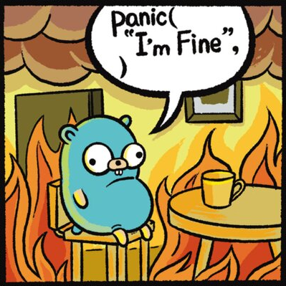
Notes:
https://www.youtube.com/watch?v=3uLKjb973HU

Slide 160
void swap(int a, int b)
{
}
Notes:
A lot of last week's demos involved swapping…
DRINKING GLASS DEMO

Slide 161
void swap(int a, int b)
{
int tmp = a;
a = b;
b = tmp;
}
Notes:
swap0.c
Have this one ready to go in a swap.c file

Slide 162
void swap(int a, int b)
{
int tmp = a;
a = b;
b = tmp;
}

Slide 163
scope

Slide 164
passing by value

Slide 165
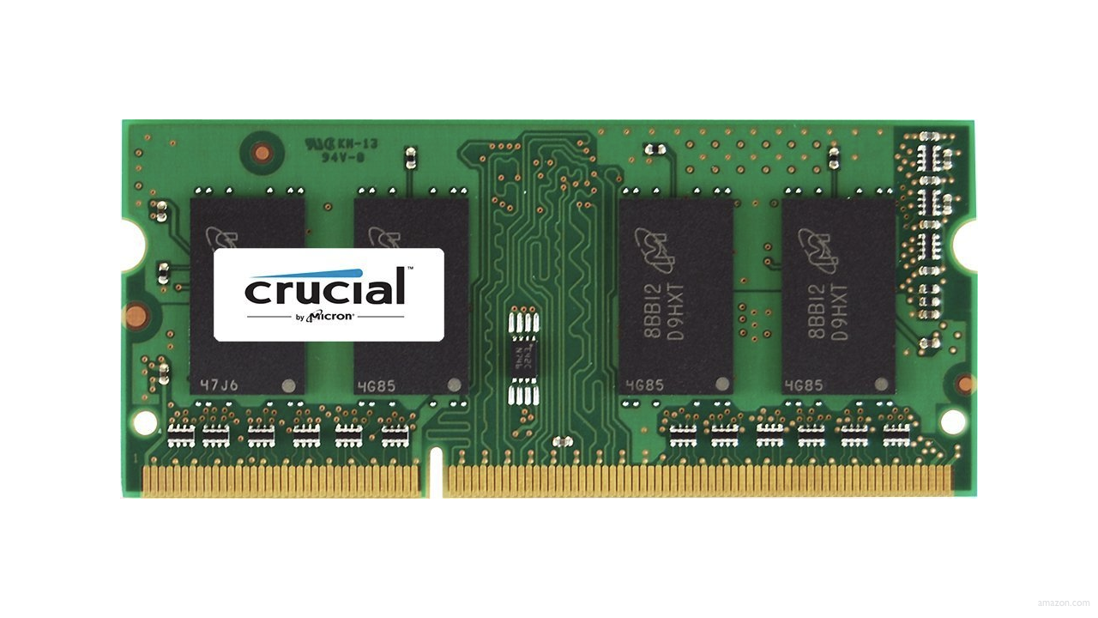

Slide 169
↑
stack

Slide 170
machine code
↑
stack

Slide 171
machine code
globals
heap
↓
↑
stack

Slide 172
machine code
globals
heap
↓
↑
stack

Slide 173
machine code
globals
heap
↓
↑
stack

Slide 174
machine code
globals
heap
↓
↑
stack

Slide 175
machine code
globals
heap
↓
↑
stack

Slide 176
↑
stack
Notes:
show swap0.c again

Slide 177
void swap(int a, int b)
{
int tmp = a;
a = b;
b = tmp;
}

Slide 178
main

Slide 179
swap
main

Slide 180
main

Slide 181
x
y

Slide 182
1
x
2
y

Slide 183
swap
1
x
2
y

Slide 184
a
b
tmp
1
x
2
y

Slide 185
1
a
2
b
tmp
1
x
2
y

Slide 186
int tmp = a;
a = b;
b = tmp;
1
a
2
b
tmp
1
x
2
y

Slide 187
int tmp = a;
a = b;
b = tmp;
1
a
2
b
1
tmp
1
x
2
y

Slide 188
int tmp = a;
a = b;
b = tmp;
2
a
2
b
1
tmp
1
x
2
y

Slide 189
int tmp = a;
a = b;
b = tmp;
2
a
1
b
1
tmp
1
x
2
y

Slide 190
2
a
1
b
1
tmp
1
x
2
y

Slide 191
1
x
2
y

Slide 192
passing by reference
Notes:
so how fix?

Slide 193
void swap(int a, int b)
{
int tmp = a;
a = b;
b = tmp;
}

Slide 194
void swap(int *a, int *b)
{
int tmp = *a;
*a = *b;
*b = tmp;
}

Slide 195
void swap(int *a, int *b)
{
int tmp = *a;
*a = *b;
*b = tmp;
}
Notes:
swap1.c

Slide 196
1
x
2
y

Slide 197
a
b
tmp
1
x
2
y

Slide 198
int tmp = *a;
*a = *b;
*b = tmp;
a
b
tmp
1
x
2
y

Slide 199
int tmp = *a;
*a = *b;
*b = tmp;
a
b
1
tmp
1
x
2
y

Slide 200
int tmp = *a;
*a = *b;
*b = tmp;
a
b
1
tmp
2
x
2
y

Slide 201
int tmp = *a;
*a = *b;
*b = tmp;
a
b
1
tmp
2
x
1
y

Slide 202
a
b
1
tmp
2
x
1
y

Slide 203
2
x
1
y

Slide 204
void swap(int a, int b)
{
int tmp = a;
a = b;
b = tmp;
}

Slide 205
void swap(int *a, int *b)
{
int tmp = *a;
*a = *b;
*b = tmp;
}

Slide 206
machine code
globals
heap
↓
↑
stack

Slide 207
heap
↓
↑
stack
Notes:
What's bad about this picture?

Slide 208
heap overflow
stack overflow

Slide 209
buffer overflow

Slide 210


Notes:
https://www.youtube.com/watch?v=9m_YXDrRkic

Slide 211
"Sensors that received the new version of Channel File 291 carrying the problematic content were exposed to a latent out-of-bounds read issue in the Content Interpreter. At the next IPC notification from the operating system, the new IPC Template Instances were evaluated, specifying a comparison against the 21st input value. The Content Interpreter expected only 20 values. Therefore, the attempt to access the 21st value produced an out-of-bounds memory read beyond the end of the input data array and resulted in a system crash."
Notes:
https://www.crowdstrike.com/wp-content/uploads/2024/08/Channel-File-291-Incident-Root-Cause-Analysis-08.06.2024.pdf

Slide 212
"Sensors that received the new version of Channel File 291 carrying the problematic content were exposed to a latent out-of-bounds read issue in the Content Interpreter. At the next IPC notification from the operating system, the new IPC Template Instances were evaluated, specifying a comparison against the 21st input value. The Content Interpreter expected only 20 values. Therefore, the attempt to access the 21st value produced an out-of-bounds memory read beyond the end of the input data array and resulted in a system crash."

Slide 213
get_char
get_double
get_float
get_int
get_long
get_string
...
Notes:
So how about these other training wheels?

Slide 214
get_int
Notes:
get0.c

Slide 215
scanf
…
Notes:
get1.c

Slide 217


Slide 218
 | 50 n

Slide 220
Notes:
get2.c

Slide 221
s

Slide 222
s

Slide 223
s

Slide 225
Notes:
get3.c

Slide 226
s
Notes:
get3.c
get_int allocates just enough memory + 1

Slide 227
file I/O

Slide 228
fopen
fclose
fprintf
fscanf
fread
fwrite
fseek
…
Notes:
phonebook{0,1}.c

Slide 229

Notes:
cp.c
https://stock.adobe.com/search/video?k=progress+bar

Slide 230
BMP

Slide 231
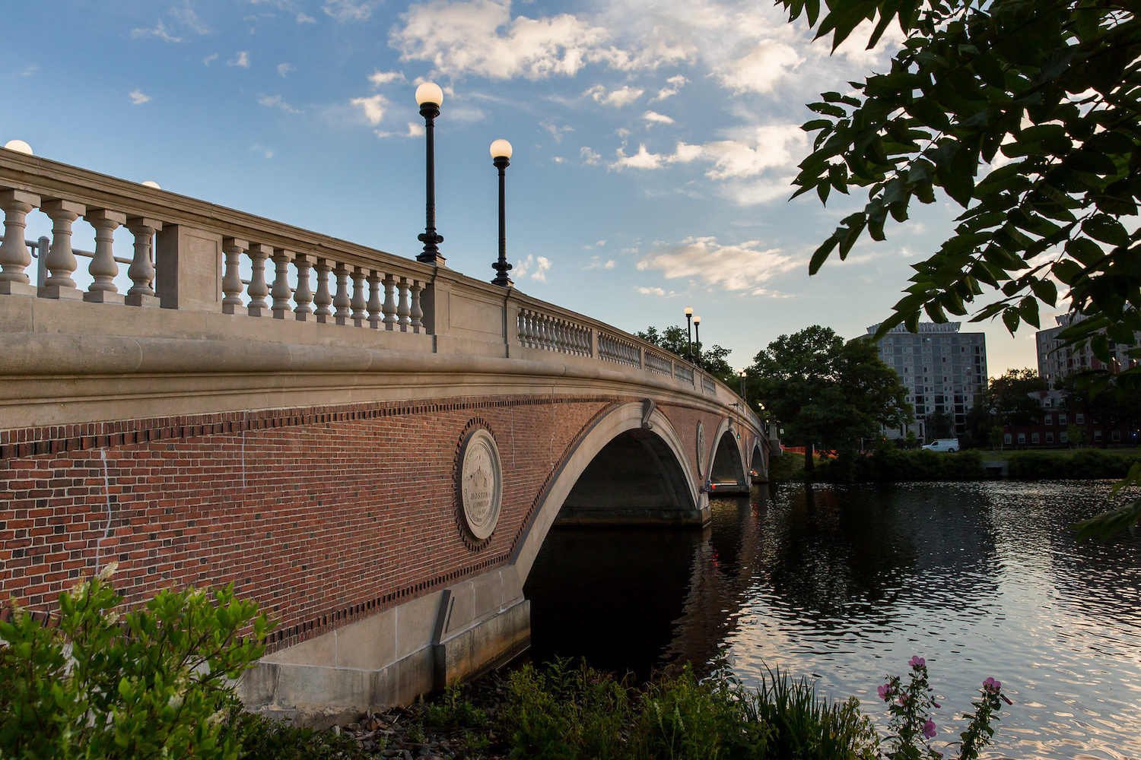

Slide 232
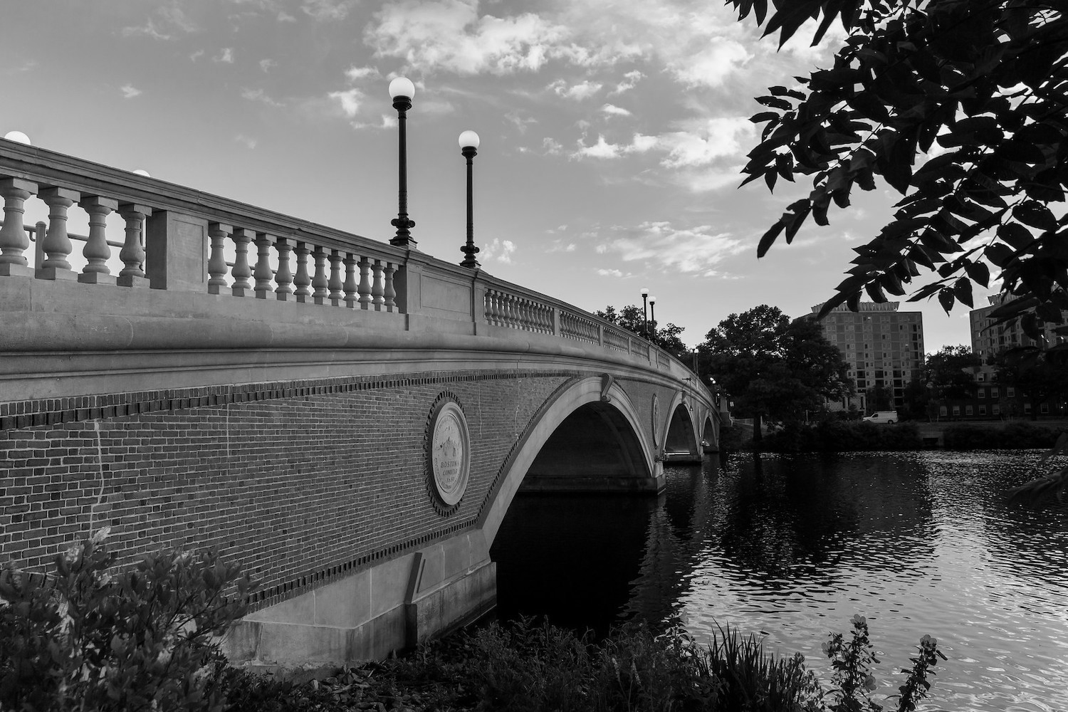
Notes:
grayscale

Slide 233
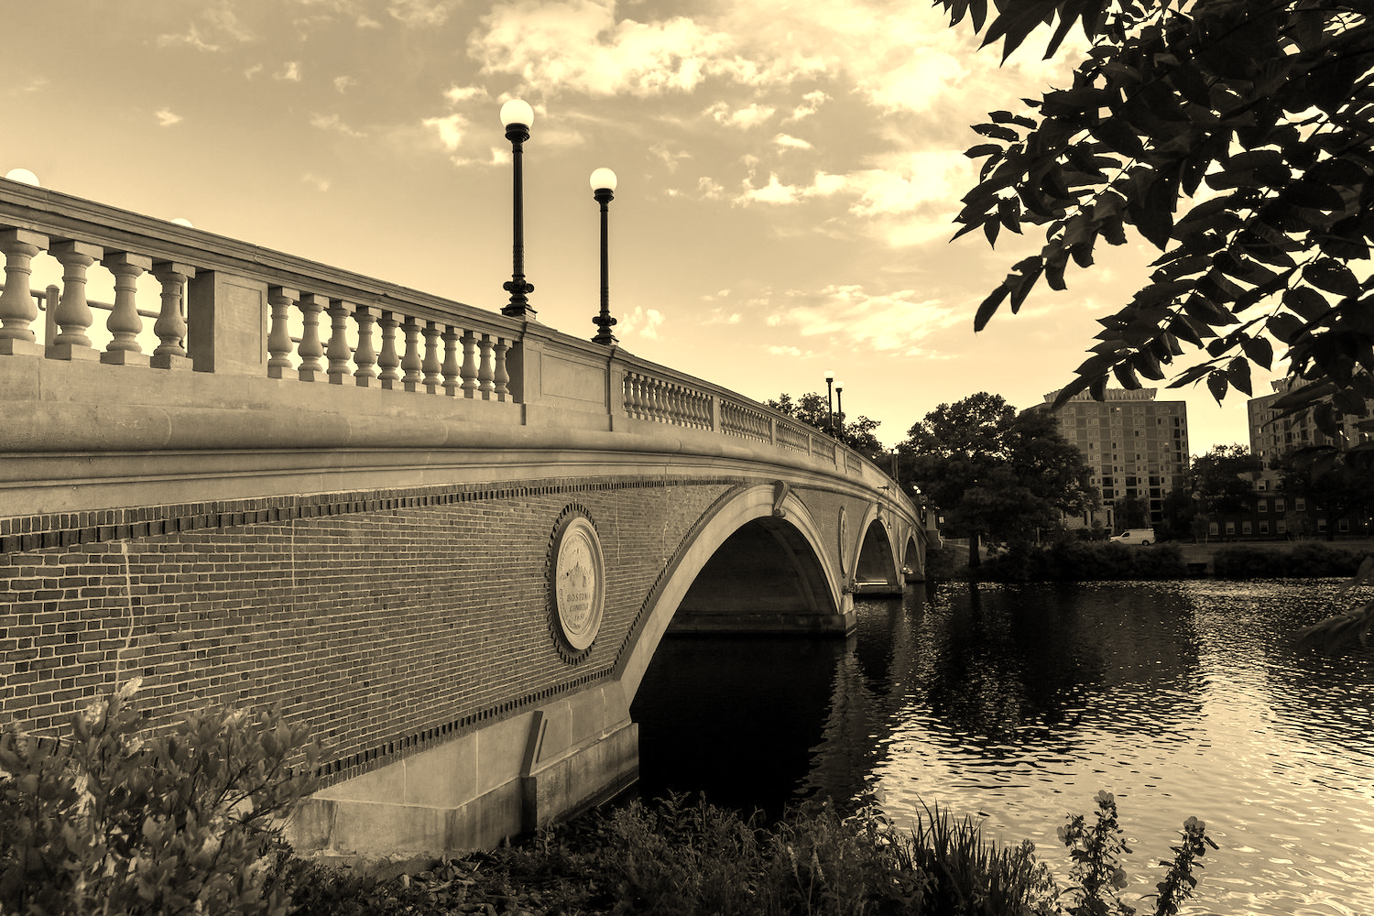
Notes:
sepia

Slide 234
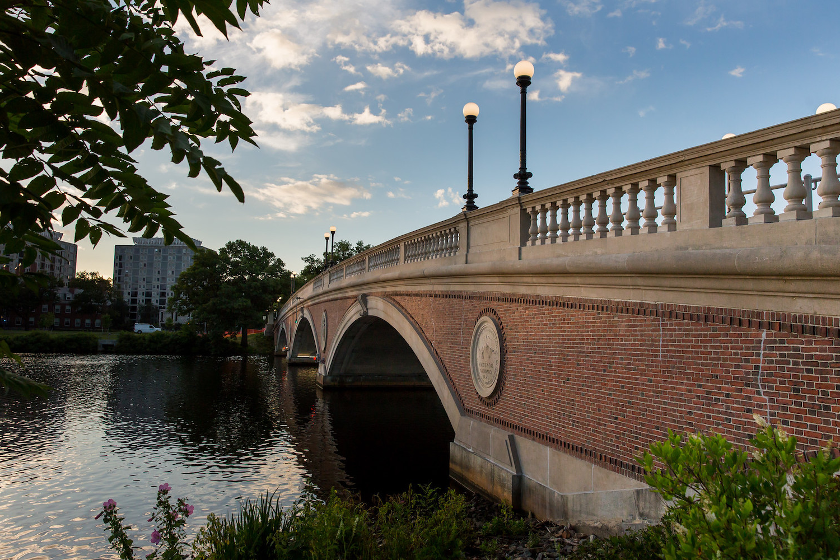
Notes:
reflect

Slide 235

Notes:
blur

Slide 236

Notes:
edge detection

Slide 237
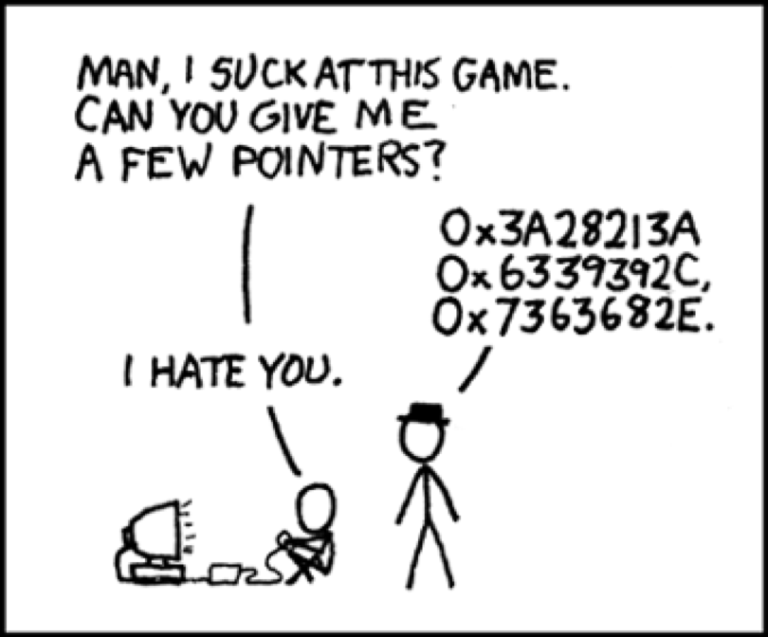
Notes:
https://xkcd.com/138/

Slide 238
Computing Technology

